Slide 1


Slide 2
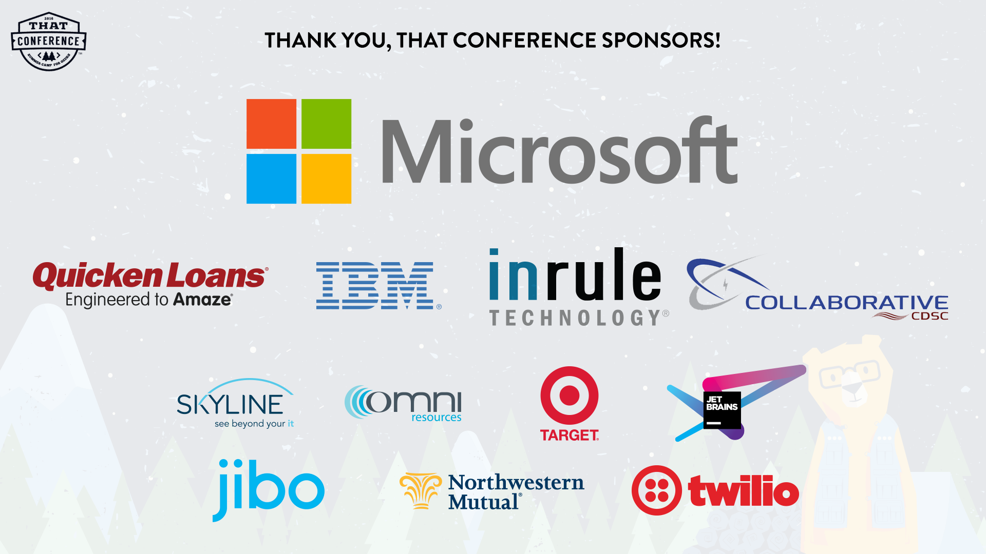

Slide 3
Full Stack ASP.NET Performance Tuning
Dustin J Ewers
Twitter: @DustinJEwers
Website: www.dustinewers.com
https://github.com/DustinEwers/asp-net-performance

Slide 4

Speak up!
(If you want to…)
Notes:
This is a discussion.
Questions
Comments
Tips

Slide 5
Roadmap
Why Bother?
What Does “Fast” Mean?
Data Layer
MVC Layer
UI/Client Side Code

Slide 6

Things we’re not going to cover
Hardware
Server Settings
SQL Server Tuning
Notes:
Hardware
Server Settings
SQL Server Tuning

Slide 7
Why Bother?
Notes:
Do we need to be fast for “lazy entitled millennials” ?
No! There are lots of reasons for quick applications.
Why should you make performance a priority?

Slide 9
Small Performance Improvements = Big Bucks
Walmart – every 1 second of load time = +2% conversion rate
Walmart – every 100 ms = +1% revenue
Staples.com – 1 second = +10% conversion rate
Mozilla – 2.2 seconds = +15.4% downloads

Slide 10
Two hundred and fifty milliseconds, either slower or faster, is close to the magic number for competitive advantage on the Web.
—HARRY SHUM,
EXECUTIVE VP OF TECHNOLOGY AND RESEARCH, MICROSOFT

Slide 11

People hate slow sites
Survey:
71% of people regularly feel inconvenienced by slow web sites
> 30% report increased performance related stress or anger

Slide 12

Slow sites are harder to use
Study:
5mb connection slowed to 2mb
Caused a 50% increase
in required concentration
Notes:
Time is Money – page 20
Concentration Measured by EEG
In 2011, CA Technologies commissioned Foviance, a customer experience consultancy, to conduct a series of lab experiments at Glasgow Caledonian Uni- versity.11 The participants wore an EEG (electroencephalography) cap to monitor their brainwave activity while they performed routine online transactions. Partici- pants completed tasks using either a 5 MB web connection or a connection that had been arti cially slowed down to 2 MB.
Brainwave analysis from the experiment revealed that participants had to concentrate up to 50% more when using websites via the slower connec- tion. When asked what they liked most and least about the websites they used during the study, participants frequently cited speed as a top concern:
Slow sites break flow and cause the user to be stressed.
Think about how this impacts testing and development, as well customer adoption

Slide 13

Do you want this to be your app?

Slide 14
Performance == Priority
Notes:
Make performance a priority
“Conventional Wisdom” warns of premature optimization. Ignore it!
Performance isn’t some magic fairy dust you can sprinkle on your app at the end.
Don’t save it until the end, because it’s like an anchor that weighs down your project
Also, bugs are way more expensive to do in the end
We don’t have “premature security”
Define non-functional requirements an enforce them throughout the project.

Slide 15

What’s Fast?
0.1 second = Instantaneous
1 second = seamless
1-10 seconds = keeps attention, (Danger Zone!)
> 10 seconds = loss of attention, (Right out!)
Notes:
Time is Money, page 16
Any break in flow is bad news.
These are based on a study from the 90’s

Slide 16
What do people expect?
49% expect load times of 2 seconds or less,
18% expect pages to load instantly
Notes:
Time is Money, page 12

Slide 17
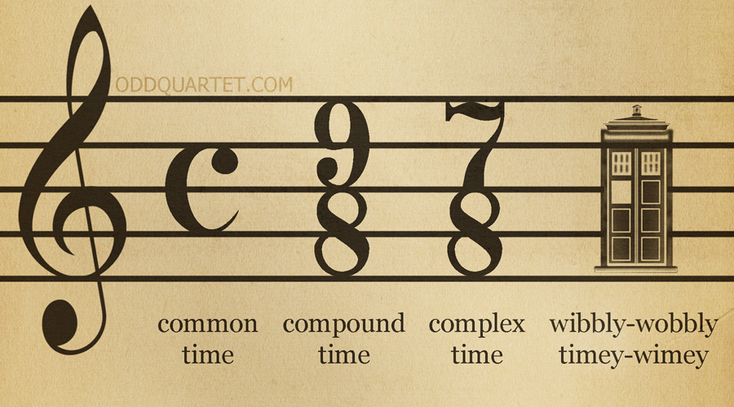
Measuring Time
Notes:
Let’s talk a little about keeping time
IT’s nice to know what “fast is, but we need to measure that somehow”

Slide 18

Tests
Unit Tests
Integration Tests
UI Tests
Load Tests
Notes:
Unit / Integration tests for correctness
UI Tests for correctness and single thread load analysis
Load tests – Try to simulate user action.

Slide 19
Individual Performance
VS.NET Profiler
Miniprofiler
Stackfy Prefix
Glimpse
Aggregate Performance
Application Insights
New Relic
Perfmon
Stackfy APM
Notes:
https://technet.microsoft.com/en-us/magazine/2008.08.pulse.aspx

Slide 20
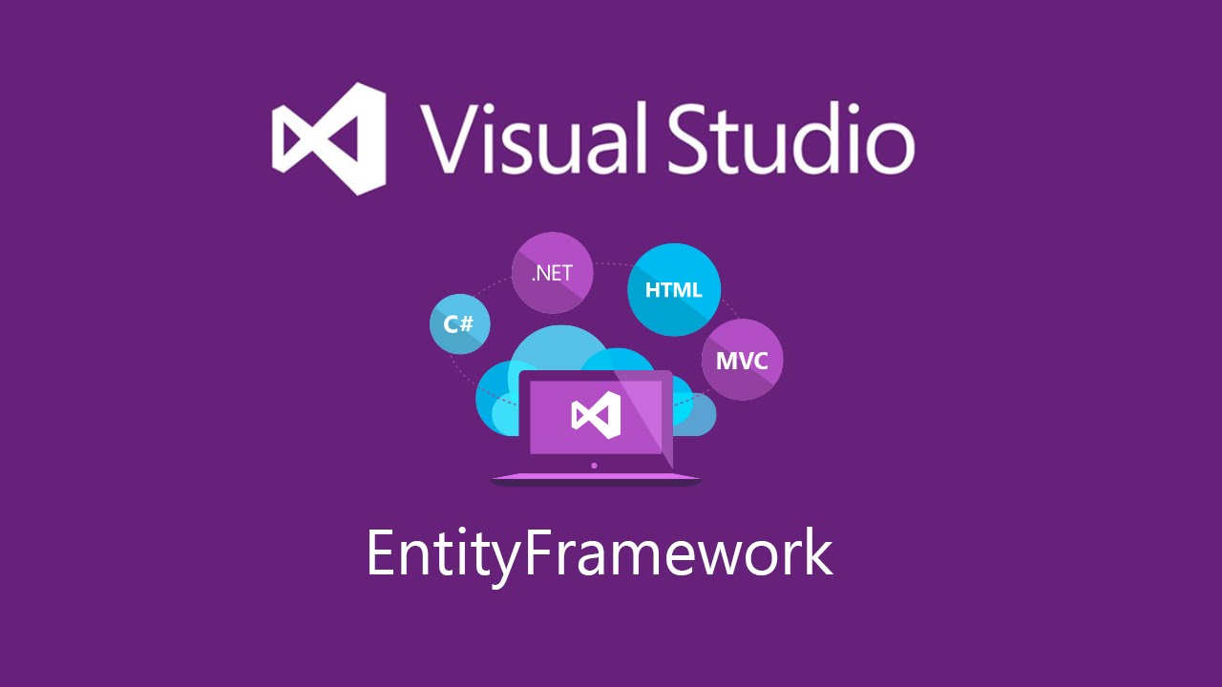
Data Layer
Notes:
Primarily focus on Entity Framework

Slide 21

Database calls are like an epic journey
Notes:
Caching for the win
Getting stuff from the database is like an epic journey in computer time.
You want to cache things that are hard to get and/or don’t change.
Lots of tools – Redis, Ncache, Memory Cache
---
Caching adds a list of
Be smart about cache expiration
Put all of your caching in one layer

Slide 22

Caching Data
Notes:
Caching for the win
Getting stuff from the database is like an epic journey in computer time.
You want to cache things that are hard to get and/or don’t change.
Lots of tools – Redis, Ncache, Memory Cache
---
Caching adds a list of design concerns
Focus on caching hard to get or infrequently changed data
Be smart about cache expiration
Put all of your caching in one layer
Abstract your cache provider

Slide 23

When you see someone get a whole 50 item object graph for a five field grid...
Notes:
Overuse of design patterns leads to situations where you call something that triggers a ton of spurious data access.
i.e. calling a whole transaction object for a few fields.
Mention builder pattern overuse
Mention Cargo Cult programming – including patterns just ‘cause

Slide 24
Demos
Notes:
Mini Profiler
Entity Framework Query optimization
- Talk about getting the data that you need

Slide 25

MVC Layer
Notes:
MVC Layer is the middle of the stack. Like the cream filling of an Oreo

Slide 26
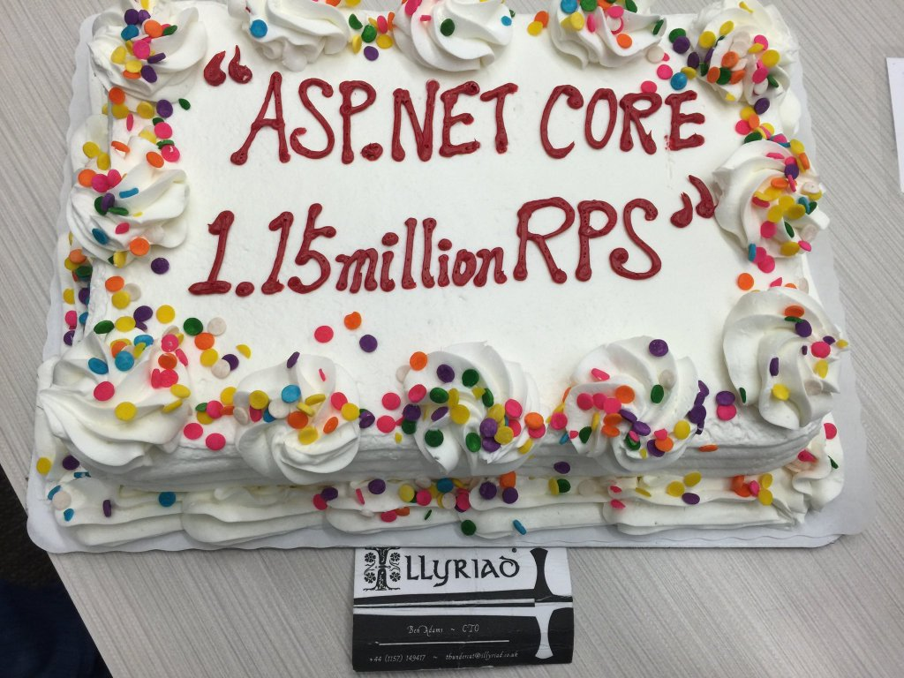
Notes:
Upgrade if you can!
ASP.NET Core is way faster than previous versions
Upwards of 2300% faster (if you believe the benchmarks)

Slide 27
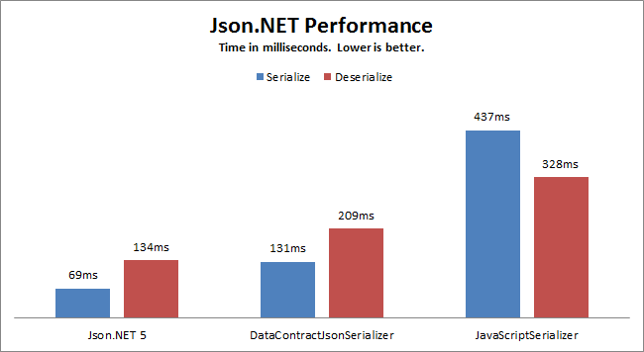
Serialization
Notes:
- Serialization can really add up in modern architectures
- Not all serializers are created equal, and the out of the box ones aren’t all that great.
Watch out for complex entities. They can trash your serialization performance
You’re not going to see this until you start heaping on the load.

Slide 28

Perhaps we should turn down
the logging level…
Notes:
Excessive production logging is a “career limiting move”

Slide 29
More Demos
Notes:
Async Demo
Session Locking
Gzip Compression on JSON results

Slide 30
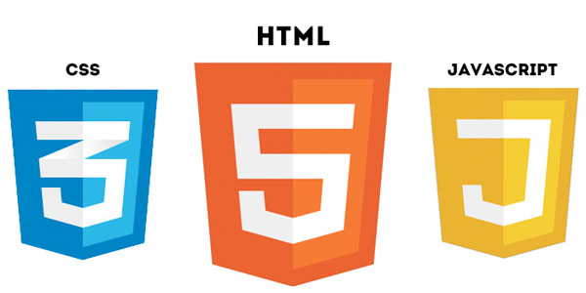
Client Side Layer

Slide 31
Bundling and Minification (JS and CSS)
Why?
Reduce file size
Reduce the number of requests
Easier to Cache
How?
ASP.NET Bundle Files
Gulp
Bundler and Minifier Extension
Notes:
Reduce the number of assets your app pipes down
https://visualstudiogallery.msdn.microsoft.com/9ec27da7-e24b-4d56-8064-fd7e88ac1c40

Slide 32
Dealing with Images
What?
Reduce file size
Reduce the number of requests
Serve them from fast servers
How?
Shrinking your images
Image sprites
Icon Font (Glyphicons/Font Awesome)
CDNs
Notes:
Reduce the number of assets your app pipes down
https://visualstudiogallery.msdn.microsoft.com/9ec27da7-e24b-4d56-8064-fd7e88ac1c40

Slide 33
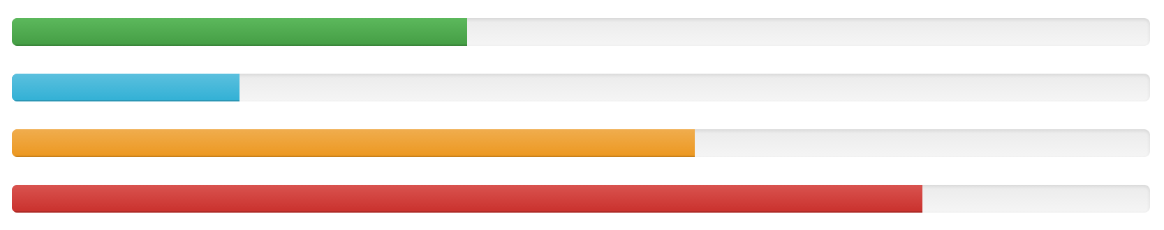


Progress Controls
Notes:
Use spinners and progress bars for long running operations
Can also do async and report back if it’s something that takes a really long time (like an import)
The key is immediate response to the user
Don’t block the user flow

Slide 34
Takeaways
Make Performance a Priority
Measure Early, Measure Often
Be Mindful of What’s Going Over the Wire

Slide 35

The Choice is Yours.

Slide 36
Questions?

Slide 37
Full Stack ASP.NET Performance Tuning
Dustin J Ewers
Twitter: @DustinJEwers
Website: www.dustinewers.com
https://github.com/DustinEwers/asp-net-performance

Slide 38


